Slide 1



Veritabanı Yöneticileri için MySQL
1. Bölüm
Sevdanur GENÇ
https://github.com/SevdanurGENC

Slide 2

Ajanda
Managing databases
Working with tables

Slide 3

Kullanılacak Kaynaklar
https://github.com/SevdanurGENC/MySQL-for-Database-Administrators-Lecture-Notes
Notes:
https://www.mysqltutorial.org/mysql-basics/

Slide 4
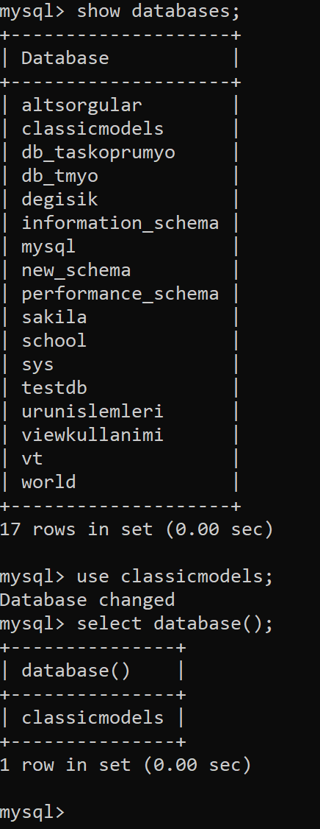
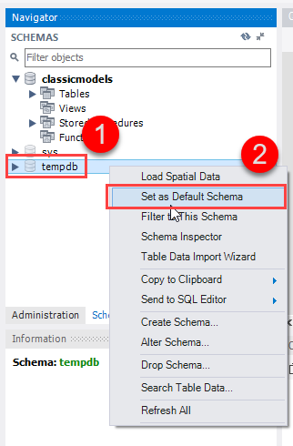
Selecting a MySQL database
SELECT database();
USE database_name;
SHOW DATABASES;

Slide 5
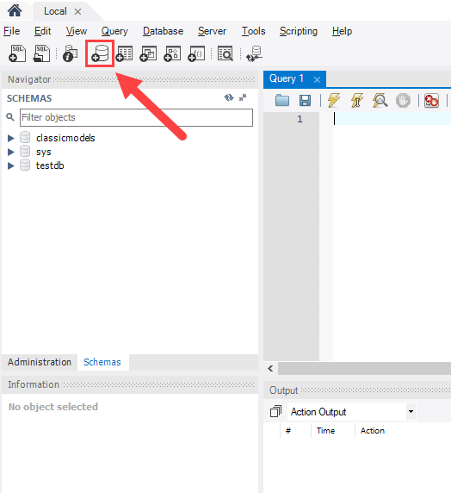
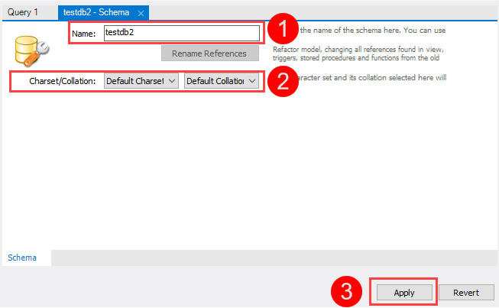
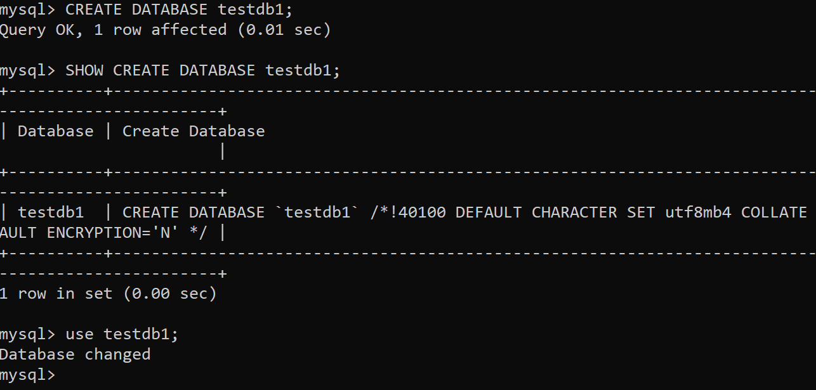
CREATE DATABASE
CREATE DATABASE testdb;
SHOW CREATE DATABASE testdb;

Slide 6
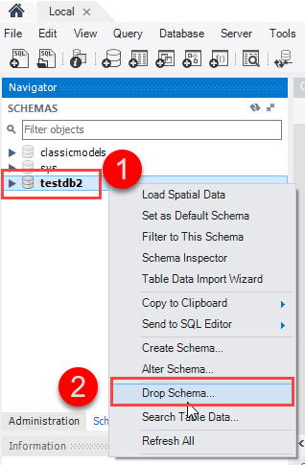
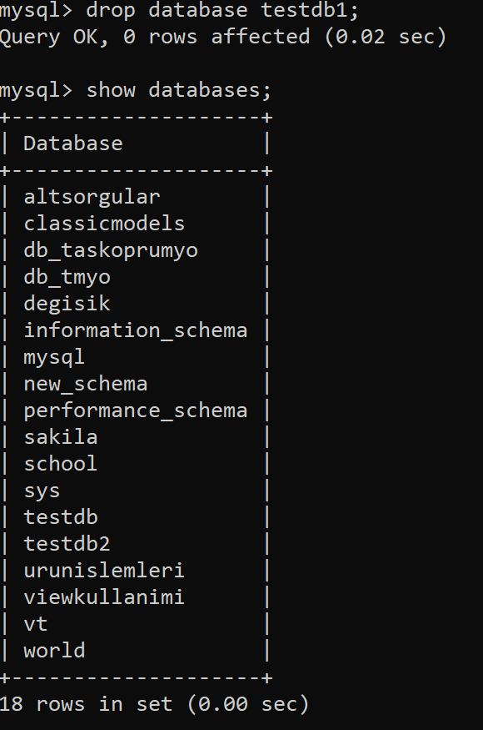
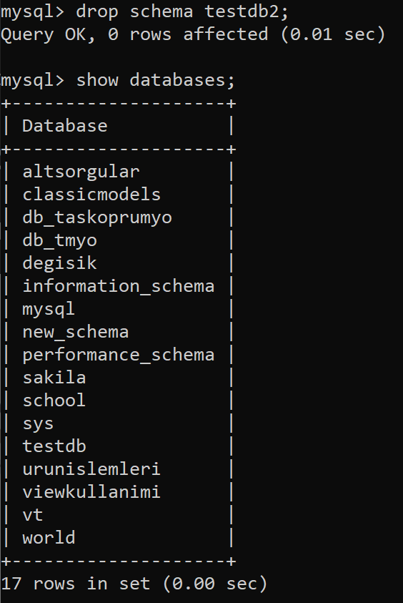
DROP DATABASE
DROP DATABASE [IF EXISTS] database_name;
DROP SCHEMA [IF EXISTS] database_name;

Slide 7
CREATE TABLE
CREATE TABLE [IF NOT EXISTS] table_name(
column_1_definition,
column_2_definition,
...,
table_constraints
) ;
CREATE TABLE IF NOT EXISTS tasks (
task_id INT AUTO_INCREMENT PRIMARY KEY,
title VARCHAR(255) NOT NULL,
start_date DATE,
due_date DATE,
status TINYINT NOT NULL,
priority TINYINT NOT NULL,
description TEXT,
created_at TIMESTAMP DEFAULT CURRENT_TIMESTAMP
) ;
DESCRIBE tasks;

Slide 8
CREATE TABLE with a foreign key primary key example
CREATE TABLE IF NOT EXISTS checklists (
todo_id INT AUTO_INCREMENT,
task_id INT,
todo VARCHAR(255) NOT NULL,
is_completed BOOLEAN NOT NULL DEFAULT FALSE,
PRIMARY KEY (todo_id , task_id),
FOREIGN KEY (task_id)
REFERENCES tasks (task_id)
ON UPDATE RESTRICT ON DELETE CASCADE
);

Slide 9
Sequence
CREATE TABLE employees (
emp_no INT AUTO_INCREMENT PRIMARY KEY,
first_name VARCHAR(50),
last_name VARCHAR(50)
);
INSERT INTO employees(first_name,last_name)
VALUES('John','Doe'),
('Mary','Jane’);
SELECT * FROM employees;
INSERT INTO employees(first_name,last_name)
VALUES('Jack','Lee’);
UPDATE employees
SET
first_name = 'Joe',
emp_no = 1
WHERE
emp_no = 3;
UPDATE employees
SET
first_name = 'Joe',
emp_no = 10
WHERE
emp_no = 3;
INSERT INTO employees(first_name,last_name)
VALUES('Wang','Lee');

Slide 10
ALTER TABLE
CREATE TABLE vehicles (
vehicleId INT,
year INT NOT NULL,
make VARCHAR(100) NOT NULL,
PRIMARY KEY(vehicleId)
);
1) Add a column to a table
ALTER TABLE vehicles
ADD model VARCHAR(100) NOT NULL;

Slide 11
ALTER TABLE
2) Add multiple columns to a table
ALTER TABLE vehicles
ADD color VARCHAR(50),
ADD note VARCHAR(255);
3) Modify a column
ALTER TABLE vehicles
MODIFY note VARCHAR(100) NOT NULL;
4) Modify multiple columns
ALTER TABLE vehicles
MODIFY year SMALLINT NOT NULL,
MODIFY color VARCHAR(20) NULL AFTER make;

Slide 12
ALTER TABLE
5) Rename a column in a table
ALTER TABLE vehicles
CHANGE COLUMN note vehicleCondition VARCHAR(100) NOT NULL;
6) Drop a column
ALTER TABLE vehicles
DROP COLUMN vehicleCondition;
7) Rename table
ALTER TABLE vehicles
RENAME TO cars;

Slide 48
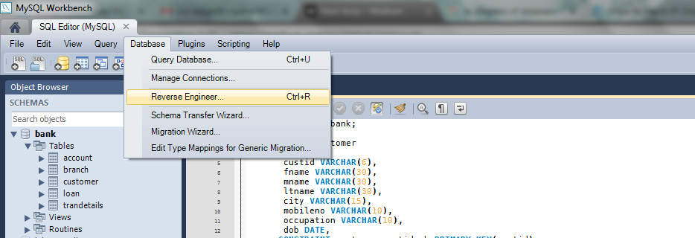
Create ER Diagram of a Database in MySQL Workbench

Slide 49


